Slide 1
vBriskett Network Automation
Daniel Hertzberg
November 2016

Slide 2
About the presenter
3 Month veteran at Arista Networks
2x CCIE RS/SP
Long time router of packets
Was a Vmware admin in a previous life
Like to drive “Race cars”
On the automation bandwagon
not a developer

Slide 3
Arista Advantage

Slide 4
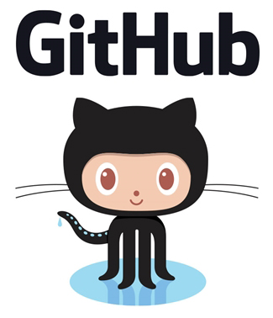


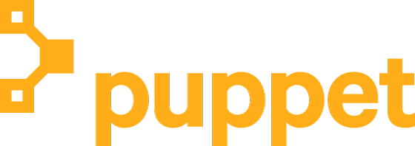
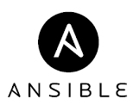

Network Automation Summary
Trends and reasons for Network automation.
Devops / Netops
Network configuration tools – Ansible and Vagrant
Continuous integration / Continuous Development with automated testing and deployment (demo)
Network Analytics and logging ELK

Slide 5
Historically deploying network infrastructure
1996
2016 +

Slide 6
Manual changes in networking

Slide 7
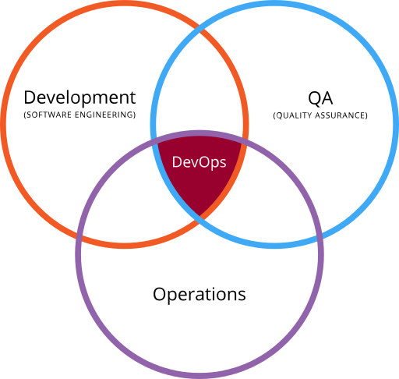
What is DevOps?
Definition of insanity – trying the same thing over and over expecting a different result.
Definition of devops– trying the same thing over and over expecting the same result.
A culture, movement or practice that emphasizes the collaboration and communication of both software developers and other information-technology (IT) professionals while automating the process of software delivery and infrastructure changes.
Notes:
DevOps Culture:
Inclusive
Sharing
Fast feedback
Collaborative
By looking at the entire lifecycle of the network teams often find that small changes in design or implementation can drastically affect operations. A closer, more inclusive culture, can create a smoother running environment and reduce surprises. Does your operations team know about every new change rolled into production? Is a network change considered complete before there in monitoring in place?
Why limit this to just networking? What about the full stack? An original request is usually about enabling a new service. Why, then, is that broken in to so many parts handled independently by so many different teams? Deploying a change to storage, networking, hosting, and application services can lead to suboptimal and staggered deployments as well as massive delays. When teams work together to solve portions of the original request, they also better understand the interactions between pieces and the original requestor has better visibility in to the process and status. With configuration management tools such as Ansible, Chef, Puppet and others, domain experts can still manage their areas of expertise but the entire solution can be version controlled, merged together in to a single, coordinated change-set to be tested, approved, and applied at one time. Further, if legacy change-management processes are still used, most configuration management tools provide a ‘no-op’ flag to report on exactly what will be changed. This output can be supplied to the final approvers and they can rest assured that these are precisely the changes that will be deployed without concern for other errors being introduced.
Change management should be at the planning stage and process review is best performed by knowledgeable peers.
Automated testing ensures that every change is tested consistently and frequently. It also frees up network engineers to perform more critical tasks
With a good DevOps workflow and toolset in place, security and compliance audits become a breeze. Auditors, first, want assurance that you know the state of your infrastructure at all times, that sufficient controls are in place to maintain business continuity, and that it meets certain minimum standards. Being able to demonstrate that every change is tested, reviewed, and deployed in a consistent manner, and, that the environment is consistently monitored for compliance goes a long way to simplifying audits.
By better managing the testing and reducing potential interactions between changes being deployed, and using automation to ensure that changes are deployed identically between test environments and production, you remove the most frequent sources of down-time.
By looking at the entire lifecycle of the network teams often find that small changes in design or implementation can drastically affect operations. A closer, more inclusive culture, can create a smoother running environment and reduce surprises. Does your operations team know about every new change rolled into production? Is a network change considered complete before there in monitoring in place?
Why limit this to just networking? What about the full stack? An original request is usually about enabling a new service. Why, then, is that broken in to so many parts handled independently by so many different teams? Deploying a change to storage, networking, hosting, and application services can lead to suboptimal and staggered deployments as well as massive delays. When teams work together to solve portions of the original request, they also better understand the interactions between pieces and the original requestor has better visibility in to the process and status. With configuration management tools such as Ansible, Chef, Puppet and others, domain experts can still manage their areas of expertise but the entire solution can be version controlled, merged together in to a single, coordinated change-set to be tested, approved, and applied at one time. Further, if legacy change-management processes are still used, most configuration management tools provide a ‘no-op’ flag to report on exactly what will be changed. This output can be supplied to the final approvers and they can rest assured that these are precisely the changes that will be deployed without concern for other errors being introduced.

Slide 8

How can DevOps practices benefit networking?
Culture
Change Management
Automated Testing
Accelerated deployment
Monitoring
Get your life back
Notes:
DevOps Culture:
Inclusive
Sharing
Fast feedback
Collaborative
By looking at the entire lifecycle of the network teams often find that small changes in design or implementation can drastically affect operations. A closer, more inclusive culture, can create a smoother running environment and reduce surprises. Does your operations team know about every new change rolled into production? Is a network change considered complete before there in monitoring in place?
Why limit this to just networking? What about the full stack? An original request is usually about enabling a new service. Why, then, is that broken in to so many parts handled independently by so many different teams? Deploying a change to storage, networking, hosting, and application services can lead to suboptimal and staggered deployments as well as massive delays. When teams work together to solve portions of the original request, they also better understand the interactions between pieces and the original requestor has better visibility in to the process and status. With configuration management tools such as Ansible, Chef, Puppet and others, domain experts can still manage their areas of expertise but the entire solution can be version controlled, merged together in to a single, coordinated change-set to be tested, approved, and applied at one time. Further, if legacy change-management processes are still used, most configuration management tools provide a ‘no-op’ flag to report on exactly what will be changed. This output can be supplied to the final approvers and they can rest assured that these are precisely the changes that will be deployed without concern for other errors being introduced.
Change management should be at the planning stage and process review is best performed by knowledgeable peers.
Automated testing ensures that every change is tested consistently and frequently. It also frees up network engineers to perform more critical tasks
With a good DevOps workflow and toolset in place, security and compliance audits become a breeze. Auditors, first, want assurance that you know the state of your infrastructure at all times, that sufficient controls are in place to maintain business continuity, and that it meets certain minimum standards. Being able to demonstrate that every change is tested, reviewed, and deployed in a consistent manner, and, that the environment is consistently monitored for compliance goes a long way to simplifying audits.
By better managing the testing and reducing potential interactions between changes being deployed, and using automation to ensure that changes are deployed identically between test environments and production, you remove the most frequent sources of down-time.
By looking at the entire lifecycle of the network teams often find that small changes in design or implementation can drastically affect operations. A closer, more inclusive culture, can create a smoother running environment and reduce surprises. Does your operations team know about every new change rolled into production? Is a network change considered complete before there in monitoring in place?
Why limit this to just networking? What about the full stack? An original request is usually about enabling a new service. Why, then, is that broken in to so many parts handled independently by so many different teams? Deploying a change to storage, networking, hosting, and application services can lead to suboptimal and staggered deployments as well as massive delays. When teams work together to solve portions of the original request, they also better understand the interactions between pieces and the original requestor has better visibility in to the process and status. With configuration management tools such as Ansible, Chef, Puppet and others, domain experts can still manage their areas of expertise but the entire solution can be version controlled, merged together in to a single, coordinated change-set to be tested, approved, and applied at one time. Further, if legacy change-management processes are still used, most configuration management tools provide a ‘no-op’ flag to report on exactly what will be changed. This output can be supplied to the final approvers and they can rest assured that these are precisely the changes that will be deployed without concern for other errors being introduced.

Slide 9
Ansible as a configuration tool
Agentless
Uses YAML
Can use Either SSH or API to connect and orchesrate network switches
Goal is simplicity
Written in Python
No Python knowledge required
One giant loop of objects
Inventory can either be dynamic or static

Slide 10
Desireable configuration
Ansible-playbook
Vlan input
Host inventory file

Slide 11
Playbook

Slide 12
Vagrant box
“Everybody has a testing environment some
People are lucky enough to have a totally
Separate environment to run production in”
--unknown
Runs a variety of different VM’s all for testing functionality
Configures a single Vagrantfile for all virtual machines
Allows users to share their own Vagrantfile with each other for testing.
Variety of boxes to pull from Vagrants

Slide 15
Jenkins-CI
Chron on steroids
Allows for continuous integration of testing
Continuos development
3rd party plugins
Blue / Green server Deployment. Why is this not applicable to networks?

Slide 16
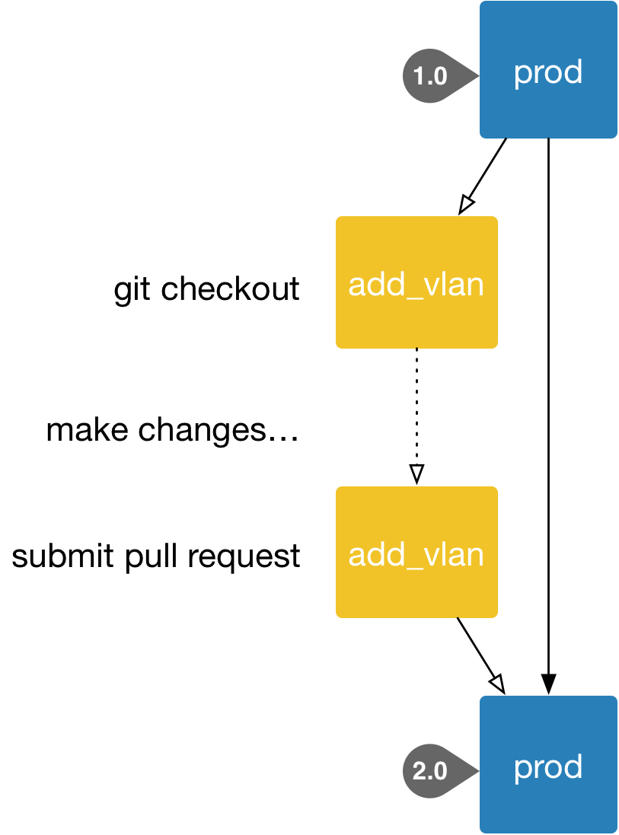
Jenkins-CI

Slide 17
ELK Stack

Slide 18
Automation and CI/CD Demo
Ansible-Play book for prod and dev
Jinja2 template to add VLANs

Slide 19
